Slide 1
Disciplinary Thinking & AI Literacy
Teaching & Learning Center
Zach Muhlbauer and Manju Adikesavan
Monday, March 4, 2024
Hyflex (On Zoom and in Room 3317), 3:00-4:30 PM

Slide 2
Workshop Overview
Part 1. Review AI tools and applications
Part 2. Unpack AI literacy framework
Application
Agency
Authenticity
Accountability
Part 3. Incorporate AI literacy practices in existing assignment

Slide 3
Part 1
Inventory of AI Tools and Application Contexts

Slide 4
Group Brainstorm: Taking Inventory of AI Tools
Prompt (1)
What AI platforms do you know of besides ChatGPT?
Respond via Poll Everywhere linked below:
Poll Everywhere

Slide 5

Some AI Tools known to the TLC Community Members

Slide 6
Group Discussion: AI Tools & Literacies within the Disciplines
Question 1.
What AI tools are most relevant to your discipline?
Question 2.
Where do you see the need for AI literacies in your discipline?

Slide 7
AI Tool Inventory
Web Resource: Thompson Rivers University AI Inventory
AI Tool | Function | Disciplinary Context
Wolfram Alpha | Solving mathematical problems, generating plots | Mathematics
Claude 2 | Idea generation and brainstorming | Humanities
Midjourney | Image generation | Art and Design
Semantic Scholar | Research and article discovery | STEM
Quillbot | Paraphrasing and revision | Writing and composition
GitHub Copilot | AI-mediated code completion | Computer science and programming
ChatGPT | Practicing conversational skills, writing assistance | Language Learning
Pandas | Data analysis and manipulation in charts and spreadsheets | Sociology, Data Science
Desmos | AI-powered graphing calculator | Mathematics

Slide 8
Part 2
Unpacking AI Literacies

Slide 9
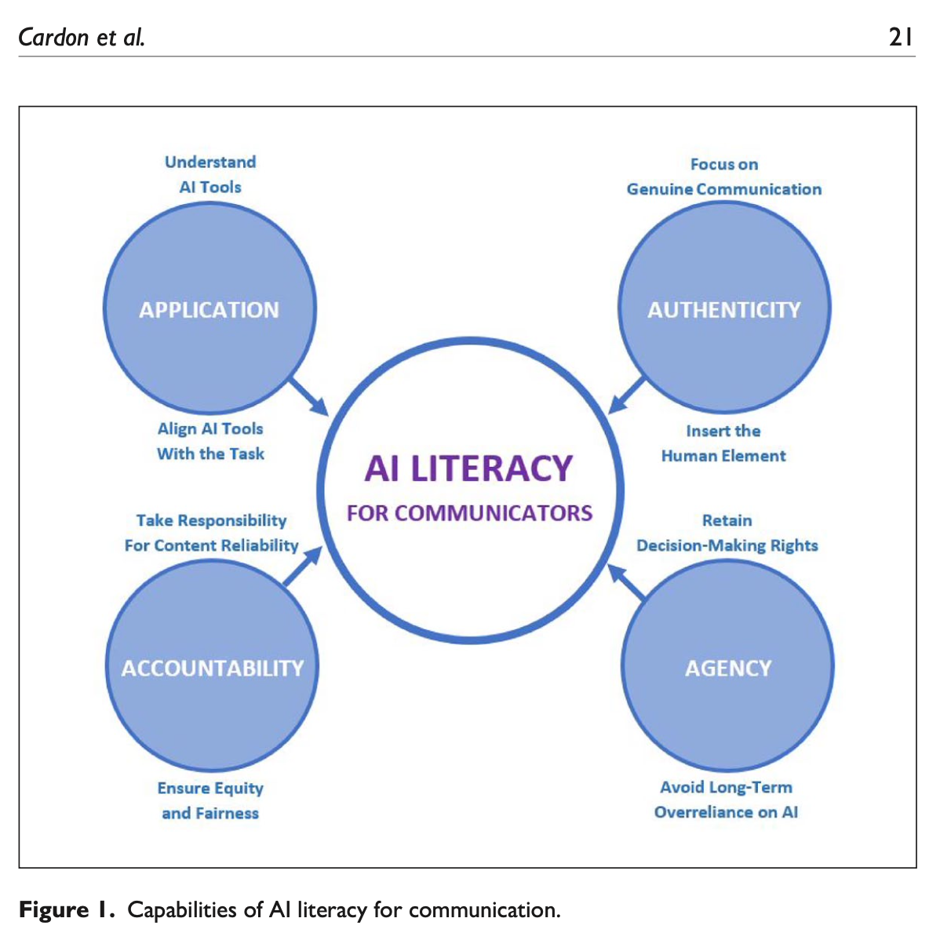
AI Literacy Framework: The Four A’s
Application → knowing how to use AI in alignment with the task at hand
Agency → leveraging AI to expand students’ independent decision-making
Authenticity → centering genuine human communication and interaction in AI uses
Accountability → validating and assuming responsibility for AI-mediated content
Source: Cardon, Peter, et al. “The Challenges and Opportunities of AI-Assisted Writing: Developing AI Literacy for the AI Age.” Business and Professional Communication Quarterly, 86(3), 257-295.

Slide 10
Activity: Adapting AI Literacy to an Assignment
Choose one of the following options from the TLC Assignment Library
Social Psychology and Comics (Low-Stakes Reflection)
Personalized Learning Plan (High-Stakes Midterm)
Philosophy Final Paper (High-Stakes Final)
Record your assignment option in the companion worksheet below:
Companion Worksheet

Slide 11
Supporting use of AI tools in application
Helping students decide which AI tool to use for different tasks
Assessing the capabilities and limitations of that tool for disciplinary learning
Establishing best practices for optimizing students’ use of that tool
e.g. strategic use of commands, prompt language, or queries
Scrutinizing the data set on which the tool has been trained

Slide 12
AI Literacy: Application
At what stage of the assignment would you have students use AI?
How can students apply AI to that stage of the assignment intentionally?
Post your response in the Google Doc (~5 minutes)

Slide 13
Adopting AI tools to exercise more (not less) agency
Assessing whether use of AI enables students to retain or expand personal choices
Ensuring students use AI intentionally to expand their knowledge and skills
Guiding students to make more independent decisions through their use of AI

Slide 14
AI Literacy: Agency
How can students use AI to expand knowledge or skills relevant to the assignment?
Post your response in Part 2 the companion worksheet (~5 minutes)

Slide 15
Ensuring AI does not compromise human authenticity
Fostering intrinsic motivation among students to express their own voice or style
Designing for interest-driven learning that promotes authentic participation
Encouraging students to build trust and credibility as part of their use of AI tools

Slide 16
AI Literacy: Authenticity
How can students express their own voice, style, or positionality in using AI for the assignment?
Post your response in Part 2 the companion worksheet (~5 minutes)

Slide 17
Establishing structures of AI accountability
Guiding students to factually verify and take responsibility for AI content
Ensuring AI tools used to support work provide equal access to all stakeholders
Teaching how to properly cite and attribute AI tools within specific disciplines

Slide 18
AI Literacy: Accountability
How will students be held accountable for their use of AI in response to the assignment?
Post your response in Part 2 the companion worksheet (~5 minutes)

Slide 19
Part 3
Incorporating AI Literacies in Your Assignments

Slide 20
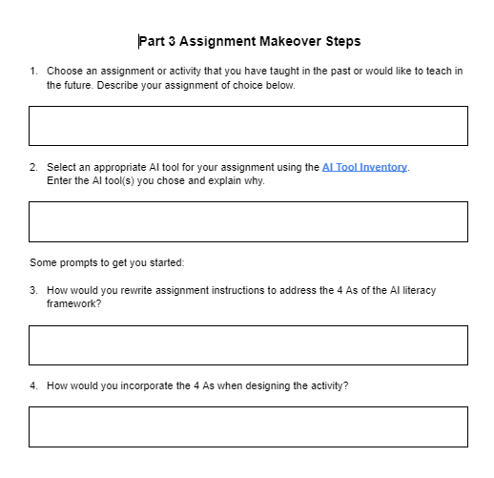
Work On Your Own Assignment Makeover ~ 15 min
Makeover Steps in the Companion Worksheet
Group Debrief after 15 mins

Slide 21
Thank You!
For more support, see the TLC’s own Teach@CUNY AI Toolkit:
https://aitoolkit.commons.gc.cuny.edu/

